Slide 1

WELCOME
COHORT 5
7th Sept – 3rd Dec 2026
Suite 6-6-7, Level 6, Menara MAA

Slide 2
Contents
Introduction to Axios
Connect FastAPI to React app
Complete Integration between frontend and backend with database

Slide 3
Introduction to Axios
Axios is a JavaScript library that simplifies making HTTP requests, enabling web and Node.js applications to interact with APIs and fetch/send data.
Axios offers a promise-based, user-friendly interface for operations like GET, POST, PUT, and DELETE, automatically transforming JSON data, handling errors, and providing features like request and response interceptors.

Slide 4
File Structure and Frontend Setup
Separate both frontend folder and backend folder as follows:
├─ ProjectName
├── Backend
├── Frontend
Create a new React app in the frontend folder and then install the following package: npm install axios

Slide 5
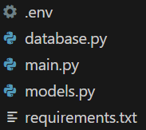
Backend Setup
Include all the codes from the previous class (6.2 Building CRUD Application with Relational Database) in the backend folder.

Slide 6
Cross-Origin Resource Sharing
Cross-Origin Resource Sharing (CORS) is an HTTP-header based security mechanism that allows servers to specify which origins (domains) are permitted to access their resources from a web browser.
In modern web applications, many web applications need to interact with third-party APIs and resources from different domains (i.e. weather data, video platforms, font libraries). CORS provides a secure way to enable this interaction.

Slide 7
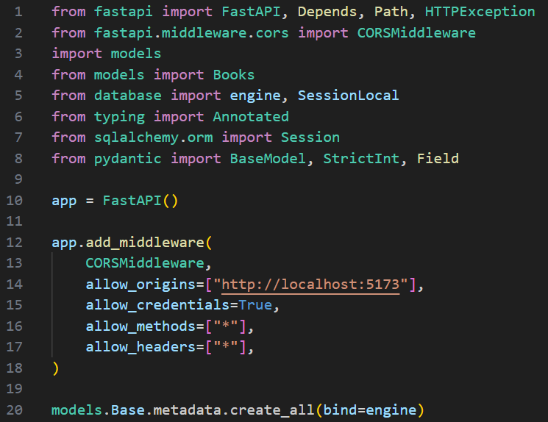
Cross-Origin Resource Sharing
Add the following codes in main.py:

Slide 8
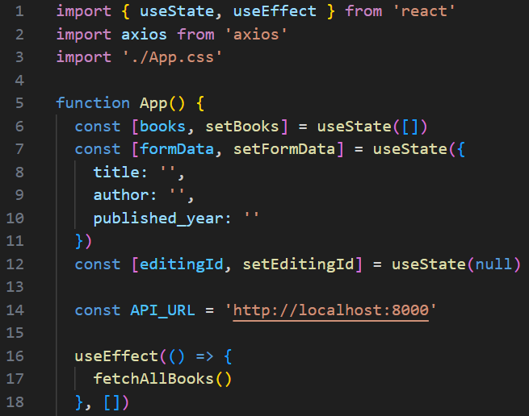
Connect FastAPI to React App
Refer to App.jsx script in your React App, replace with the following:

Slide 9
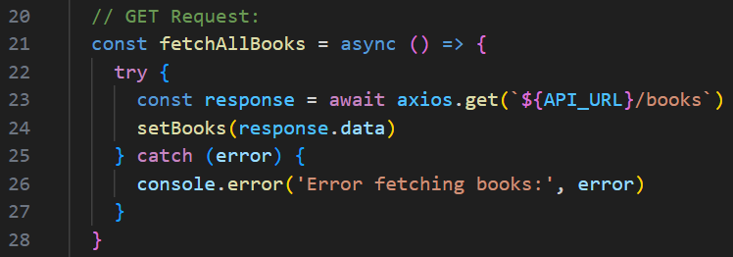
Connect FastAPI to React App
App.jsx (Continue):

Slide 10
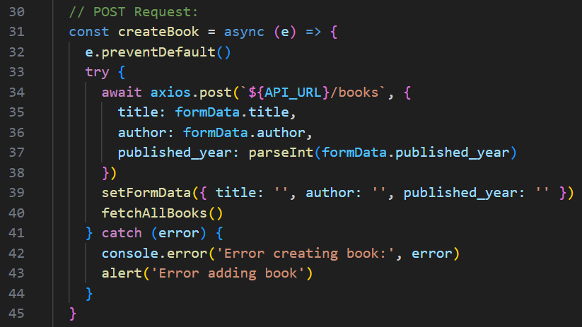
Connect FastAPI to React App
App.jsx (Continue):

Slide 11
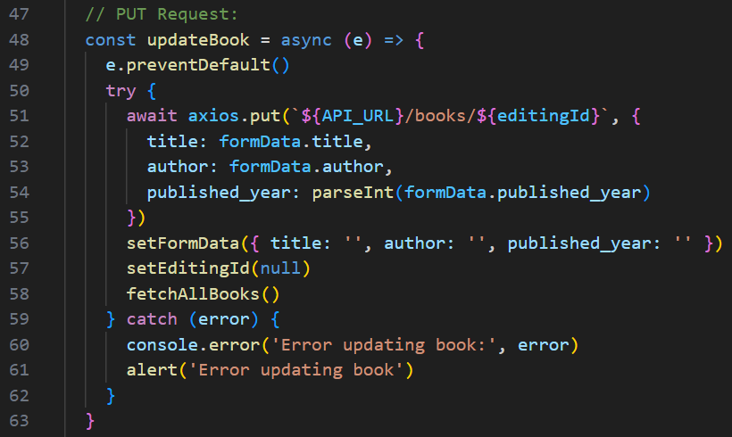
Connect FastAPI to React App
App.jsx (Continue):

Slide 12
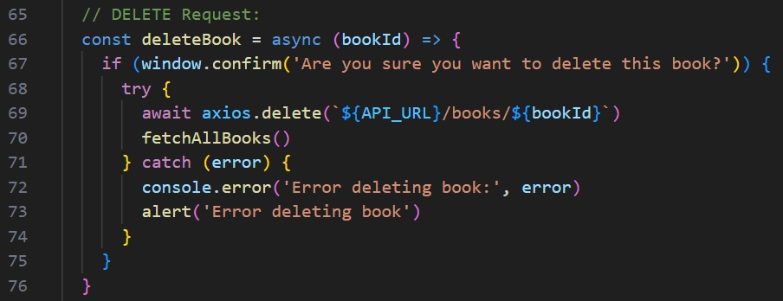
Connect FastAPI to React App
App.jsx (Continue):

Slide 13
Connect FastAPI to React App
The rest of the codes for App.jsx is provided in the speaker notes for your reference.
Run the application and perform CRUD operations by adding new data, read existing data, update, and delete existing data. Make sure the uvicorn server is running during the test.
Compare and validate the data with your database in PostgreSQL.
Notes:
const startEdit = (book) => {
setEditingId(book.id)
setFormData({
title: book.title,
author: book.author,
published_year: book.published_year
})
}
const cancelEdit = () => {
setEditingId(null)
setFormData({ title: '', author: '', published_year: '' })
}
return (
<>
<h2 style={{ textAlign: 'center', marginBottom: '20px', marginTop: '10px' }}>Book Management System</h2>
<div style={{
display: 'flex',
gap: '20px',
alignItems: 'flex-start',
maxWidth: '1600px',
margin: '0 auto',
padding: '0 20px',
height: 'calc(100vh - 100px)',
boxSizing: 'border-box'
}}>
{/* Form Container */}
<div className="card" style={{
flex: '0 0 380px',
minWidth: '300px',
maxWidth: '380px',
border: '1.5px solid #000000',
borderRadius: '10px',
padding: '20px',
display: 'flex',
flexDirection: 'column',
height: '100%',
maxHeight: '70vh',
boxSizing: 'border-box',
overflow: 'hidden'
}}>
<h3 style={{ margin: '0 0 15px 0' }}>
{editingId ? 'Update Book' : 'Add New Book'}
</h3>
<form onSubmit={editingId ? updateBook : createBook} style={{
display: 'flex',
flexDirection: 'column',
gap: '15px',
flex: 1,
overflow: 'auto'
}}>
<div>
<label style={{ display: 'block', marginBottom: '5px', fontWeight: 'bold', textAlign: 'left' }}>
Title
</label>
<input
type="text"
placeholder="Enter book title"
value={formData.title}
onChange={(e) => setFormData({ ...formData, title: e.target.value })}
required
style={{ width: '100%', padding: '8px', boxSizing: 'border-box' }}
/>
</div>
<div>
<label style={{ display: 'block', marginBottom: '5px', fontWeight: 'bold', textAlign: 'left' }}>
Author
</label>
<input
type="text"
placeholder="Enter author name"
value={formData.author}
onChange={(e) => setFormData({ ...formData, author: e.target.value })}
required
style={{ width: '100%', padding: '8px', boxSizing: 'border-box' }}
/>
</div>
<div>
<label style={{ display: 'block', marginBottom: '5px', fontWeight: 'bold', textAlign: 'left' }}>
Published Year
</label>
<input
type="number"
placeholder="Enter publication year"
value={formData.published_year}
onChange={(e) => setFormData({ ...formData, published_year: e.target.value })}
required
min="1801"
max="2025"
style={{ width: '100%', padding: '8px', boxSizing: 'border-box' }}
/>
</div>
<div style={{ display: 'flex', gap: '10px', marginTop: 'auto' }}>
<button type="submit" style={{ flex: '1', padding: '10px' }}>
{editingId ? 'Update Book' : 'Add Book'}
</button>
{editingId && (
<button type="button" onClick={cancelEdit} style={{ flex: '1', padding: '10px' }}>
Cancel
</button>
)}
</div>
</form>
</div>
{/* Table Container */}
<div className="card" style={{
flex: '1',
minWidth: '700px',
maxWidth: '1200px',
border: '1.5px solid #000000',
borderRadius: '10px',
padding: '20px',
display: 'flex',
flexDirection: 'column',
height: '100%',
maxHeight: '70vh',
boxSizing: 'border-box',
overflow: 'hidden'
}}>
<h3 style={{ margin: '0 0 15px 0' }}>Books List</h3>
{books.length === 0 ? (
<p>No book available</p>
) : (
<div style={{
overflowY: 'auto',
overflowX: 'hidden',
flex: 1
}}>
<table style={{
width: '100%',
borderCollapse: 'collapse',
tableLayout: 'fixed'
}}>
<thead style={{
position: 'sticky',
top: 0,
backgroundColor: '#000000',
color: '#ffffff',
zIndex: 1
}}>
<tr>
<th style={{
borderLeft: '1px solid #000000',
padding: '8px',
width: '35%'
}}>Title</th>
<th style={{
borderLeft: '1px solid #000000',
padding: '8px',
width: '25%'
}}>Author</th>
<th style={{
borderLeft: '1px solid #000000',
padding: '8px',
width: '15%'
}}>Year</th>
<th style={{
borderLeft: '1px solid #000000',
borderRight: '1px solid #000000',
padding: '8px',
width: '25%'
}}>Actions</th>
</tr>
</thead>
<tbody>
{books.map((book) => (
<tr key={book.id}>
<td
style={{
border: '1px solid #000000',
borderTop: '1px solid #ffffff',
padding: '8px',
overflow: 'hidden',
textOverflow: 'ellipsis',
whiteSpace: 'nowrap',
wordBreak: 'break-all'
}}
title={book.title}
>
{book.title}
</td>
<td
style={{
border: '1px solid #000000',
borderTop: '1px solid #ffffff',
padding: '8px',
overflow: 'hidden',
textOverflow: 'ellipsis',
whiteSpace: 'nowrap'
}}
title={book.author}
>
{book.author}
</td>
<td style={{
border: '1px solid #000000',
borderTop: '1px solid #ffffff',
padding: '8px',
textAlign: 'center' }}>
{book.published_year}
</td>
<td style={{
border: '1px solid #000000',
borderTop: '1px solid #ffffff',
padding: '8px',
textAlign: 'center',
whiteSpace: 'nowrap'
}}>
<button
onClick={() => startEdit(book)}
style={{
marginRight: '8px',
padding: '6px 12px',
minWidth: '60px'
}}
>
Edit
</button>
<button
onClick={() => deleteBook(book.id)}
style={{
padding: '6px 12px',
minWidth: '60px'
}}
>
Delete
</button>
</td>
</tr>
))}
</tbody>
</table>
</div>
)}
</div>
</div>
</>
)
}
export default App

Slide 14
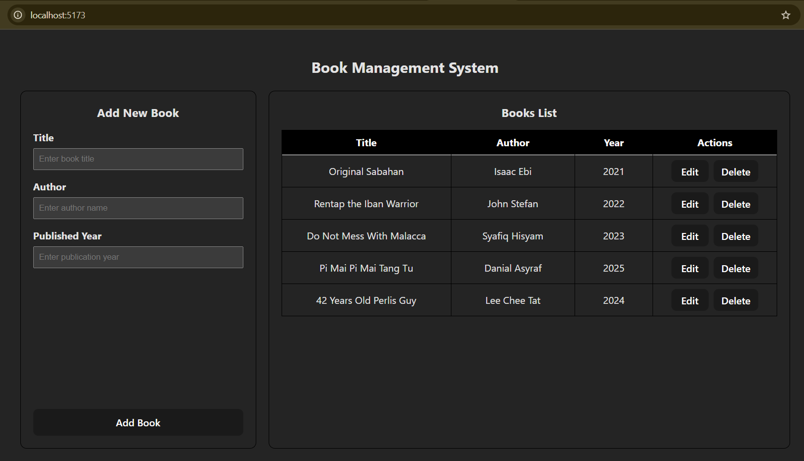
Connect FastAPI to React App
Frontend localhost UI from React App project folder:
Books list in your frontend should reflect the same information from your database in PostgreSQL.

Slide 15
Exercise
Frontend:
Create a components folder and a component file to import into App.jsx.
Change from inline styles to external styles by creating a css file to be imported in the component file.
OPTIONAL - Redesign the user interface of the application by using a frontend framework of your choice (i.e. Tailwind CSS, React Bootstrap, etc.)
2. Backend:
Add any relevant endpoints or database modification to improve your application (i.e. Adding more information field such as book’s price, genre, customer review, etc.)

